Slide 1
Assessment of the Older Person
Keith Cameron

Slide 2
The Same Priorities?
Geriatric patients tend to report fewer symptoms but have more chronic diseases.
Presentations likely to be atypical
Emphasis on 4 matters of concern for older people:
  Immobility
  Instability
  Impaired intellect
  Incontinence
Any of these may be caused or worsened by polypharmacy – very common problem in elderly patients

Slide 3
Comprehensive Geriatric Assessment – Components (A to I)
Activities of daily living
Balance, frailty testing
Cognition
Depression, Drugs (polypharmacy), Dentition (Including nutrition and weight loss)
Environment: home situation, social support, financial issues, living will.
Falls Risk (history of falls, ‘get up and go’ test, functional reach test)
Gait speed (faster walkers have better survival)
Hearing, vision
Incontinence (urine or stool), sexual function

Slide 4
A Standard History Taking?
Changes?
Slow down the speed of the interview.
Adjust your interview approach if the patient has hearing or visual impairment, or dementia.
To maximise the interaction, ensure that he/she can see your face when you talk to them.
Do not patronise the patient.
With the patient’s permission, involve a relative or friend to help with the interview.

Slide 5
Falls- Risk Factors
History of multiple previous falls (number, Injuries)
Age over 80years
Difficulty in getting up fro a chair
Use of a walking stick or frame
Arthritis
Poor Vision
Cognitive decline or depression
Muscle weakness
Parkinson’s disease
Gait or balance problems
Mechanical problems in the home (e.g. loose rugs or steep stairs)
Drug treatment (polypharmacy; particularly note sedatives, antidepressants, antihypertensives)

Slide 6
Lawton & Brody
Instrumental Activities of daily Living
(IADL) Scale
1 Ability to use the phone
2 Shopping
3 Food preparation
4 Housekeeping
5 Laundry
6 Transport
7 Medication management
8 Ability to handle finances

Slide 7
Lawton & Brody
Instrumental Activities of daily Living
(IADL) Scale
Score 1 for each element:
0 = Total Dependence
8 = Total Independence
Lawton & Brody (1969)

Slide 8
Katz Index of Activities of Daily Living(ADLs)
1 Bathing
2 Dressing
3 Toileting
4 Transferring
5 Continence
6 Feeding

Slide 9
Katz Index of Activities of Daily Living(ADLs)
1 point for each element that can be done without help or supervision
6 = Fully functional
4 = Moderately Impaired
2 = Severely Impaired
Katz et al (1970)

Slide 10
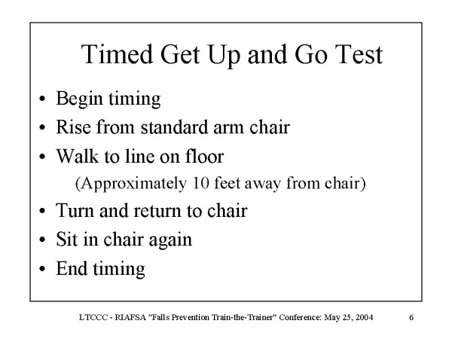
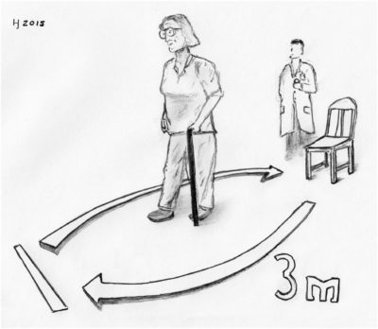
Timed ‘Get up and Go’ Test

Slide 11
Timed ‘Get up and Go’ Test
Normal time for completion 7-10 seconds
Over 10 seconds, some mobility difficulties (especially over 20 seconds)
Douglas et al (2013)

Slide 12
References
DOUGLAS, G., NICOL, F. and ROBERTSON, C. eds., 2013. Macleod's Clinical Examination E-Book. Elsevier Health Sciences.
KATZ, S., DOWNS, T., CASH, H. and GROTZ, R. 1970. Progress in development of the index of ADL. The gerontologist, 10(1_Part_1), pp.20-30.
LAWTON, M., & BRODY, E. 1969. Assessment of Older People: Self-Maintaining and Instrumental Activities of Daily Living, The Gerontologist, Volume 9, Issue 3_Part_1, 1 October 1969, Pages 179-186, https://doi.org/10.1093/geront/9.3_Part_1.179

